Slide 1
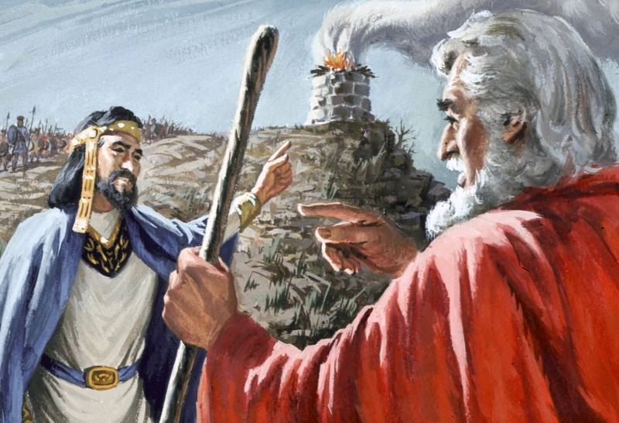
1 Samuel 13:1-14
Saul’s Wickedness.

Slide 2
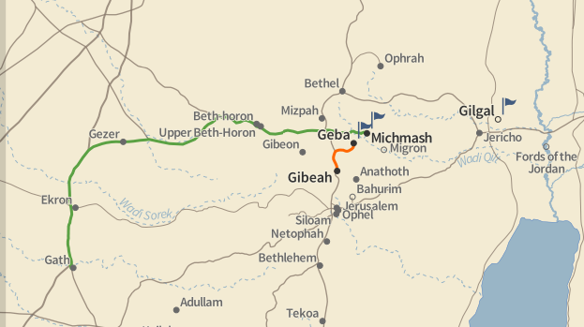

Slide 4
A test of faith.
When we refuse to wait on the
promises of God, we ruin lives!
Notice: pride casts blame instead
of taking personal responsibility.
Saul blames everyone but himself.
The immature blames others for
their sin! Gen 3:9-11

Slide 5


Leaders! Pay attention. You are replaceable.

Slide 6
1 Samuel 13:15-23
A weak army.
Lacking warriors.

Slide 7
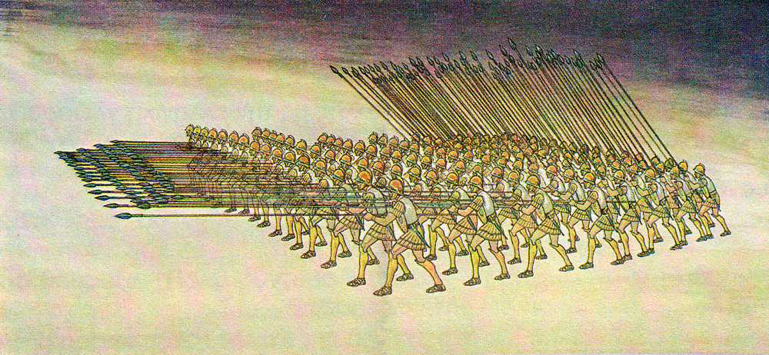
Israel’s Weakness.
600 soldiers.
Is that enough to take out
the army in verse 5?
FAITH KNOWS the answer: With the LORD 600 is overkill!
Saul walked by sight. He saw only his circumstances because he was weak in faith!

Slide 8
1 John 5:4 For whatsoever is born of God overcometh the world: and this is the victory that overcometh the world, even our faith.

Slide 9
Daniel 11:32b …but the people that do know their God shall be strong, and do exploits.

Slide 10
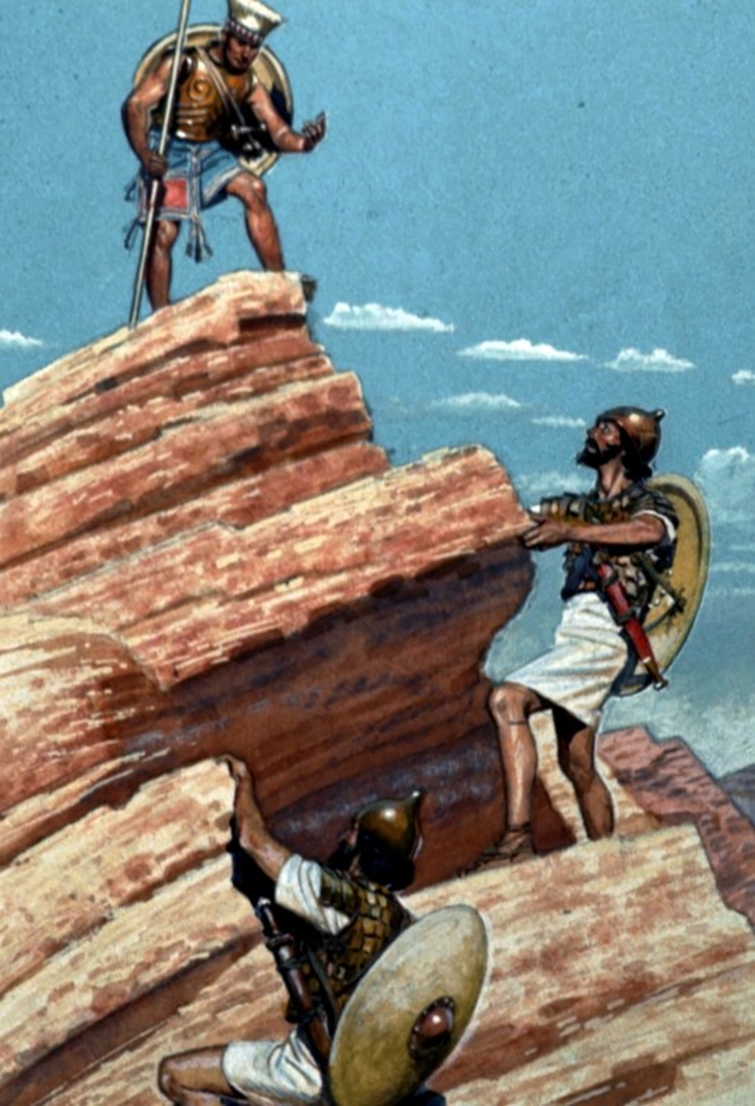
How many needed to fight to win the victory in chapter 14?
TWO!

Slide 11
Judges 7:12 And the Midianites and the Amalekites and all the children of the east lay along in the valley like grasshoppers for multitude; and their camels were without number, as the sand by the sea side for multitude.

Slide 12
Leaders: Fear is an inferior motivator.
Faith is far superior!

Slide 13
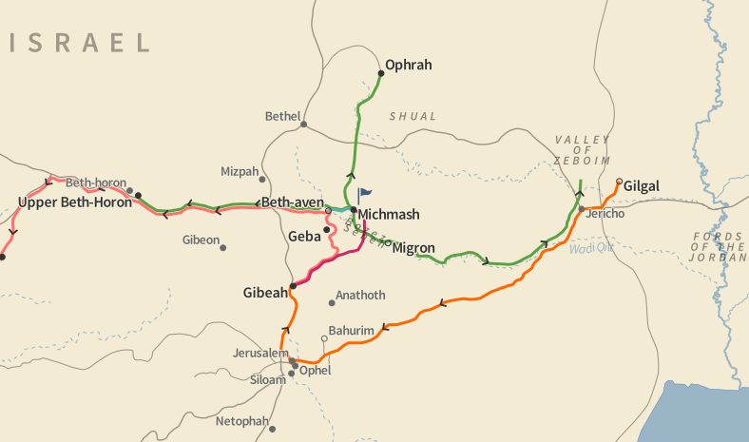

Slide 14
A helpless army: lacking weapons.
Pay attention to the picture here.
Facing a battle when God’s people only have two swords?
They were unarmed.

Slide 15
Ephesians 6:10-17 Finally, my brethren, be strong in the Lord, and in the power of his might. 11 Put on the whole armour of God, that ye may be able to stand against the wiles of the devil. 12 For we wrestle not against flesh and blood, but against principalities, against powers, against the rulers of the darkness of this world, against spiritual wickedness in high places. 13 Wherefore take unto you the whole armour of God, that ye may be able to withstand in the evil day, and having done all, to stand.
17 And take the helmet of salvation, and the sword of the Spirit, which is the word of God:

Slide 16
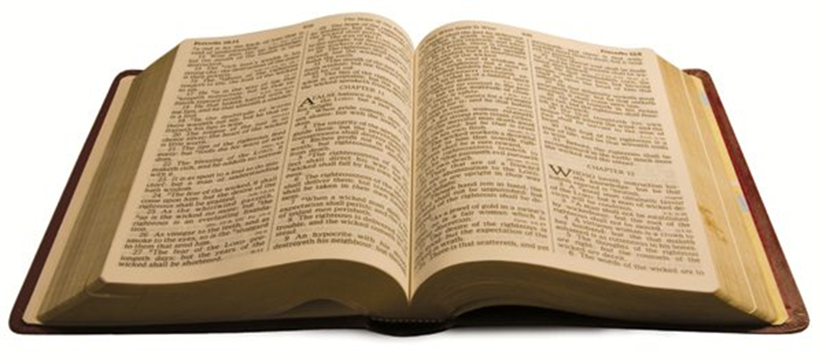
A helpless army: lacking weapons.
Pay attention to the picture here.
Facing a battle when God’s people only have two swords?
The enemy is working to steal the Sword of the Spirit / The Word of God from God’s people.
The goal is to replace the swords with inferior tools.

Slide 17


Slide 18
1 Samuel 17:45-47 Then said David to the Philistine, Thou comest to me with a sword, and with a spear, and with a shield: but I come to thee in the name of the LORD of hosts, the God of the armies of Israel, whom thou hast defied. 46 This day will the LORD deliver thee into mine hand; and I will smite thee, and take thine head from thee; and I will give the carcases of the host of the Philistines this day unto the fowls of the air, and to the wild beasts of the earth; that all the earth may know that there is a God in Israel. 47 And all this assembly shall know that the LORD saveth not with sword and spear: for the battle is the LORD'S, and he will give you into our hands.

